Slide 1
ASP.NET Core Fundamentals
App settings, configuration providers, environments

Slide 2
Environments
Environments are digital spaces where the development, testing and publishing of a website or web app is taking place.
It’s a collection of resources that host a website or web app.
Generally, app environments can be divided into three main categories, with each their own unique purpose and functionalities: the development environment, the staging or testing environment and the production environment.
The three environments form a mechanism that brings together all the components of an app into one space that deploys them.
Environments can be compared to a recording studio for a musician: it’s an essential space for creating and recording high-quality products.

Slide 3
Development
A development environment is where most of the technical programming takes place and is used by developers to build applications and write their code.
Generally, development environments are set up on local PC’s and facilitated by a Git repository.

Slide 4
Staging
Developers can test if the application including all its functionalities, works properly in a realistic setting.
Check for potential bug and bug fixes
Used to demo newly finished work to the product owner
Let end-users test the product and receive valuable feedback before pushing it to the production environment

Slide 5
Production
When the development team, product owners, and end-users have thoroughly tested the product in the staging environment, the web app is pushed to the production environment
Used for official launch of the application
Contains live data and it’s accessible to the public
Production environment is where the finished product enters the market, ready for commercial use.

Slide 6
Production
The production environment should be configured to maximize security, performance, and application robustness. Some common settings that differ from development include:
Caching.
Client-side resources are bundled, minified, and potentially served from a CDN.
Diagnostic error pages disabled.
Friendly error pages enabled.
Production logging and monitoring enabled. For example, using Application Insights.

Slide 7
Setting environment in ASP.NET Core
To determine the runtime environment, ASP.NET Core reads from the following environment variables:
DOTNET_ENVIRONMENT
ASPNETCORE_ENVIRONMENT
The ASPNETCORE_ENVIRONMENT value overrides DOTNET_ENVIRONMENT.

Slide 8
Development and launchSettings.json
The development environment can enable features that shouldn't be exposed in production
The environment for local machine development can be set in the Properties\launchSettings.json file of the project.
Environment values set in launchSettings.json override values set in the system environment.
The launchSettings.json file:
Is only used on the local development machine.
Is not deployed.
Contains profile settings.

Slide 9
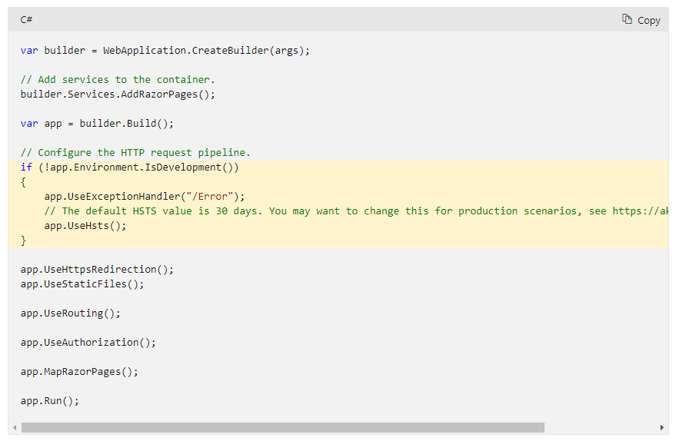
Configure services and middleware by environment
The highlighted code checks the current environment while building the request pipeline.

Slide 10
Application settings
To "configure your app," generally speaking, is to specify, via some mechanism, parameters that can be used to direct the behavior of your app at runtime
Notes:
Above, the DataStore is a generic class. T is called type parameter, which can be used as a type of fields, properties, method parameters, return types, and delegates in the DataStore class. For example, Data is generic property because we have used a type parameter T as its type instead of the specific data type.

Slide 11
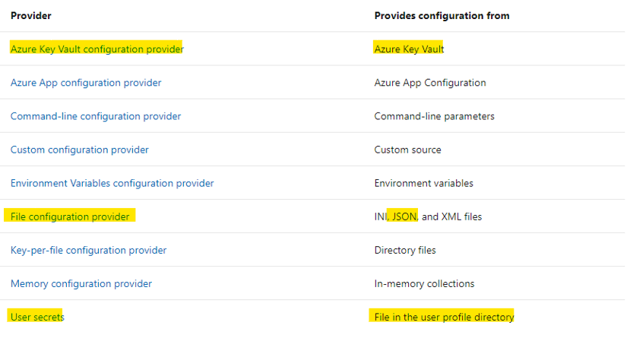
Configuration in ASP.NET Core
Configuration in ASP.NET Core is performed using one or more configuration providers.
Configuration providers read configuration data from key-value pairs using a variety of configuration sources:

Slide 12
Configuration in ASP.NET Core
Configuration sources are read in the order that their configuration providers are specified.
A typical sequence of configuration providers is:
appsettings.json
appsettings.Environment.json
User secrets
Environment variables using the Environment Variables configuration provider.
Command-line arguments using the Command-line configuration provider.

Slide 13
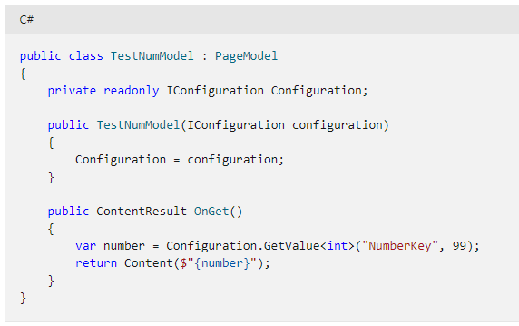
GetValue
ConfigurationBinder.GetValue<T>
Extracts a single value from configuration with a specified key and converts it to the specified type.
In the following example, if NumberKey isn't found in the configuration, the default value of 99 is used.

Slide 14
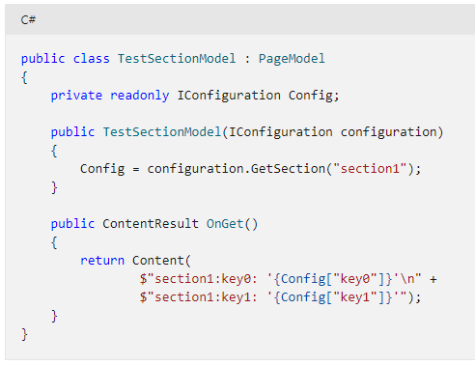
GetSection
IConfiguration.GetSection
Returns a configuration subsection with the specified subsection key.
The following code returns values for section1:

Slide 15
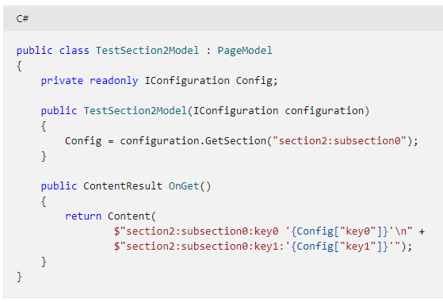
GetSection
The following code returns values for section2:subsection0:

